Slide 1
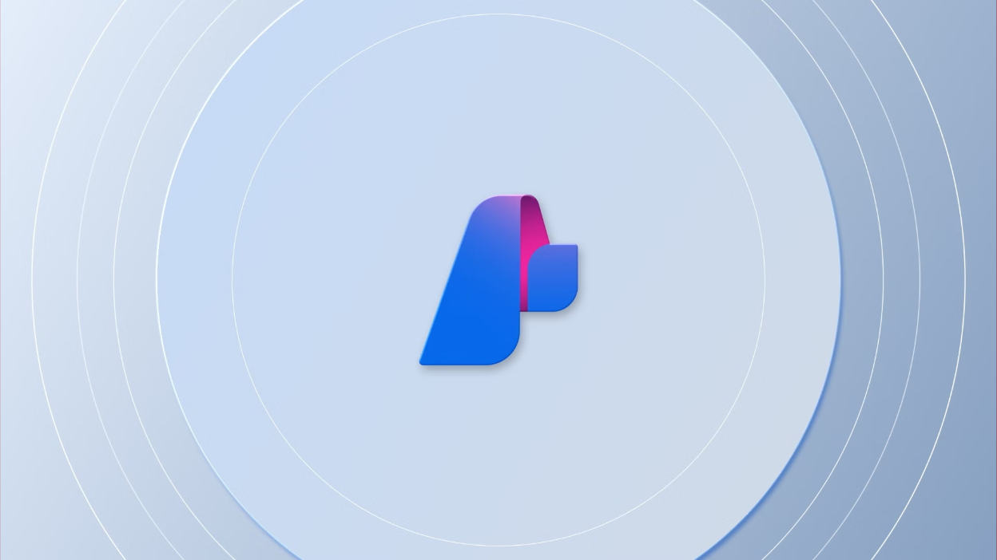
Introduction to Azure AI Agents Service

Slide 2
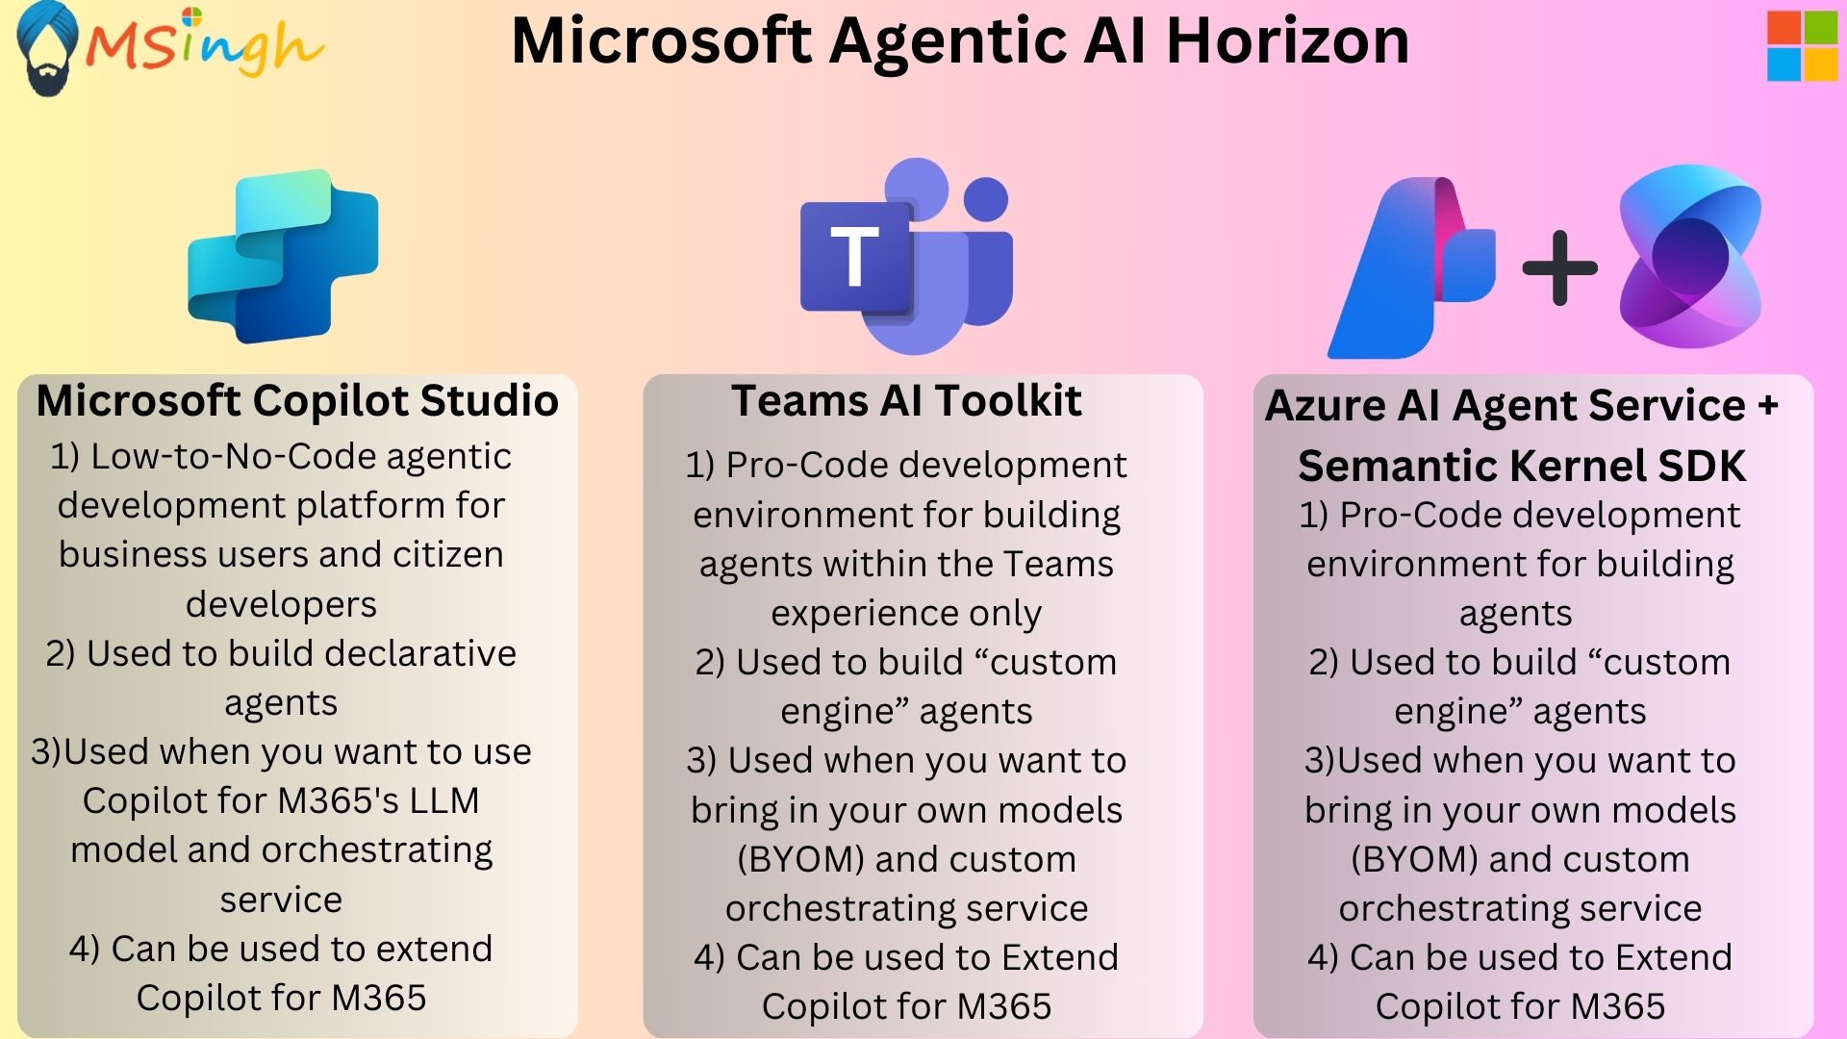

Slide 3
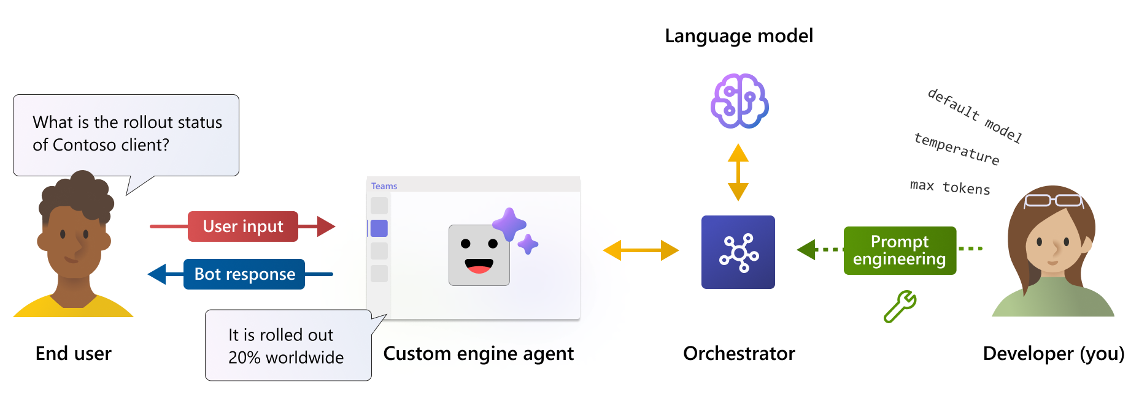
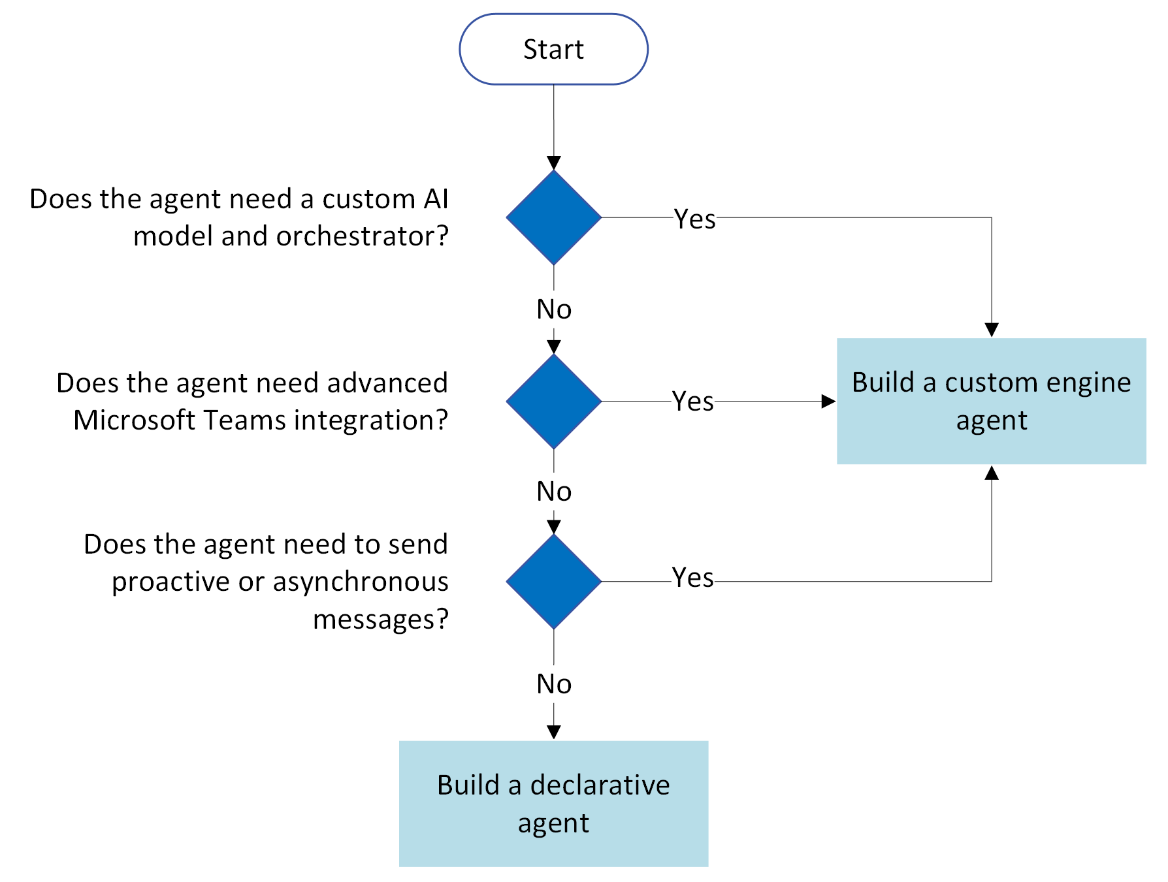
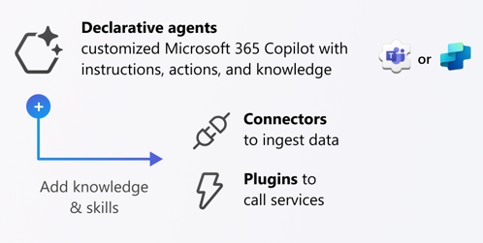
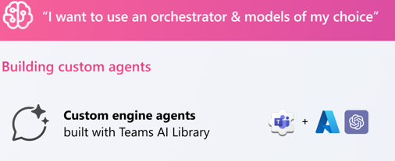
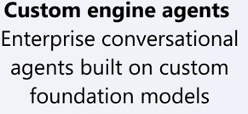

Slide 4
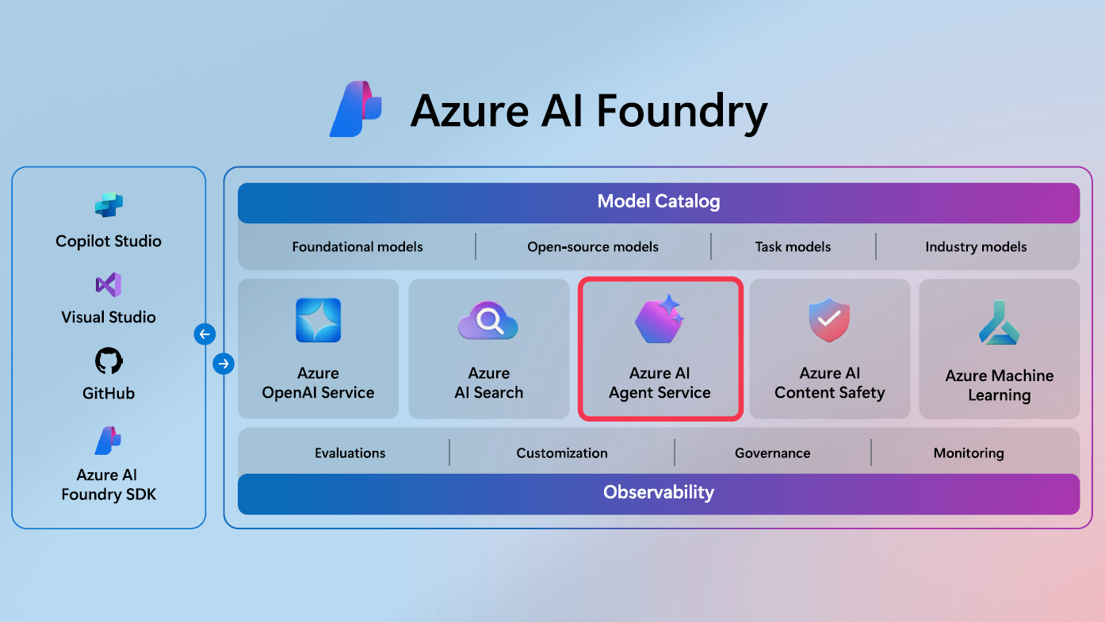
Azure AI Agent Service is available in the Azure Ai Studio Hub (under the Azure AI Foundry portal), so we will be working a lot with Azure AI Studio Hub
Within Azure AI Foundry, an AI Agent acts as a "smart" microservice that can be used to answer questions (RAG), perform actions, or completely automate workflows
Azure AI Agent Service is a fully managed service designed to empower developers to securely build, deploy, and scale high-quality, and extensible AI agents without needing to manage the underlying compute and storage resources.
Microsoft has released a SDK dedicated specifically to building agents with the Azure AI Agent service; Works like butter!
To create an AI Agent with Azure AI Foundry SDK, you can simply define which model the AI uses, the instructions for how it should complete tasks, and the tools it can use to access and interact with other services.
Notes:
Flexible model selection - Create agents that use Azure OpenAI models, or others such as Llama 3, Mistral and Cohere. Choose the most suitable model to meet your business needs.
Extensive data integrations - Ground your AI agents with relevant, secure enterprise knowledge from various data sources, such as Microsoft Bing, Azure AI Search, and other APIs.
Enterprise grade security - Ensure data privacy and compliance with secure data handling, keyless authentication, and no public egress.
Choose your storage solution - Either bring your own Azure Blob storage for full visibility and control of your storage resources, or use platform-managed storage for secure ease-of-use.

Slide 5
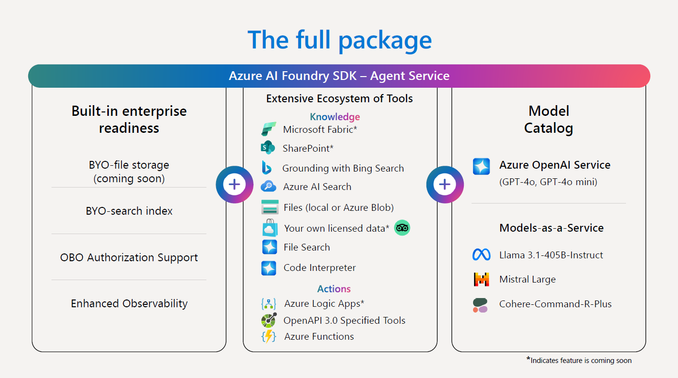
Enable your agent to perform external interactions with the world, such as calling APIs or asynchronously sending and waiting for events.
Ground your Agent’s knowledge with Microsoft Fabric, Azure AI Search index, Bing Search for real-time information retrieval etc.
Create and run automated workflows with Azure Logic Apps with little to no code using the visual designer and selecting from prebuilt operations. Also use OpenAPI Specified tools to make API calls via your agent
Your agent will not be tied to only Azure OpenAI models but rather other models from the model catalog too!

Slide 6
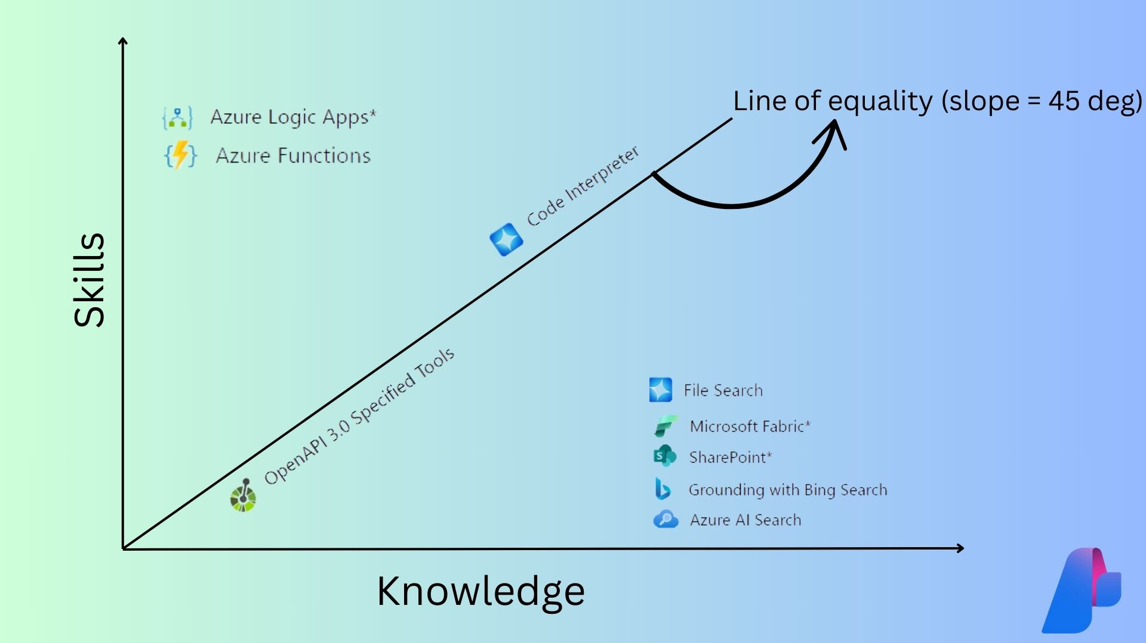
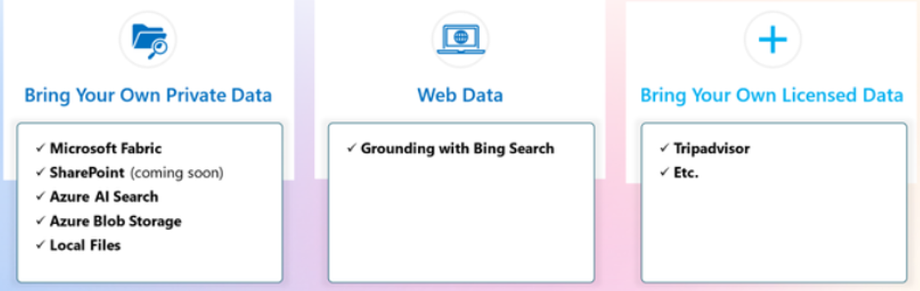

Slide 7
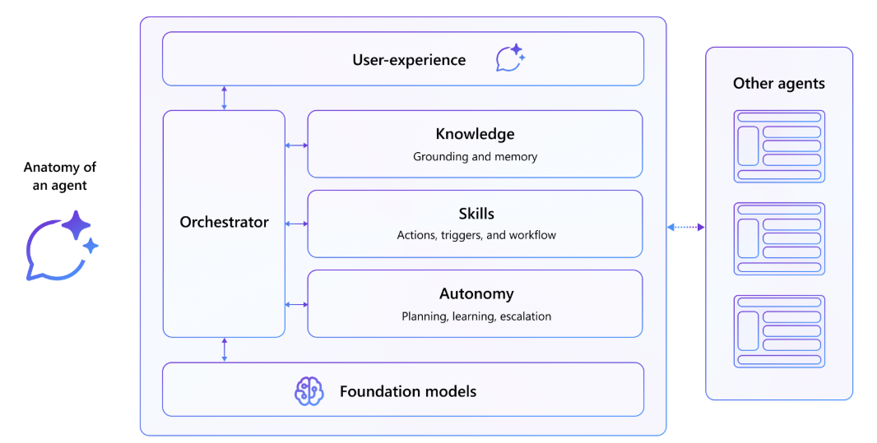
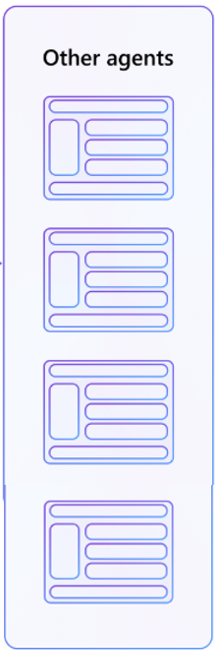
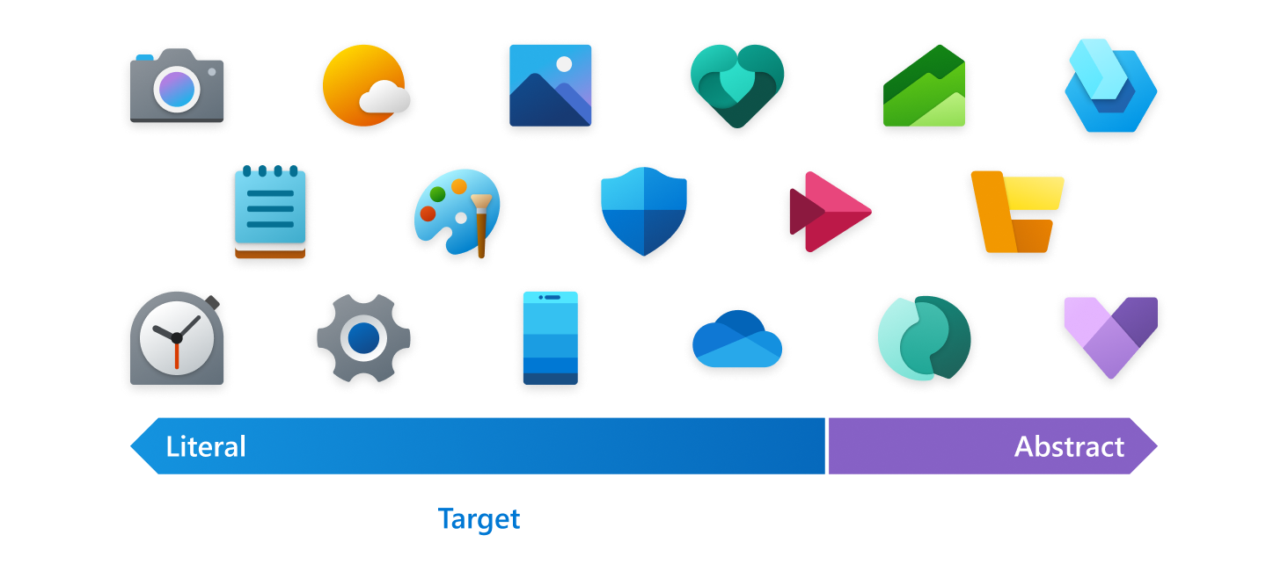
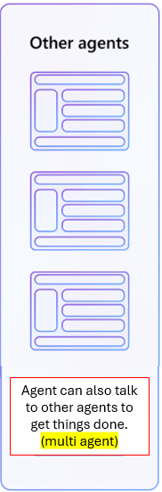


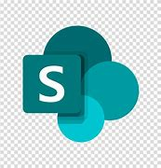



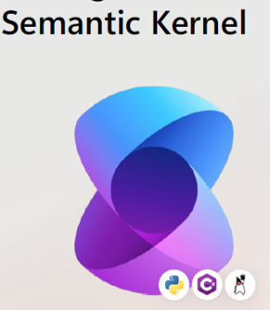



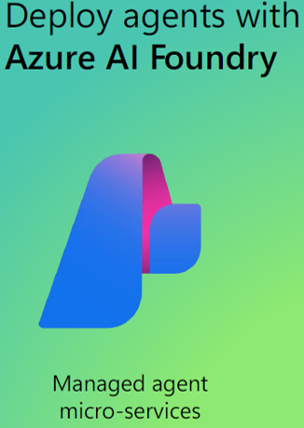
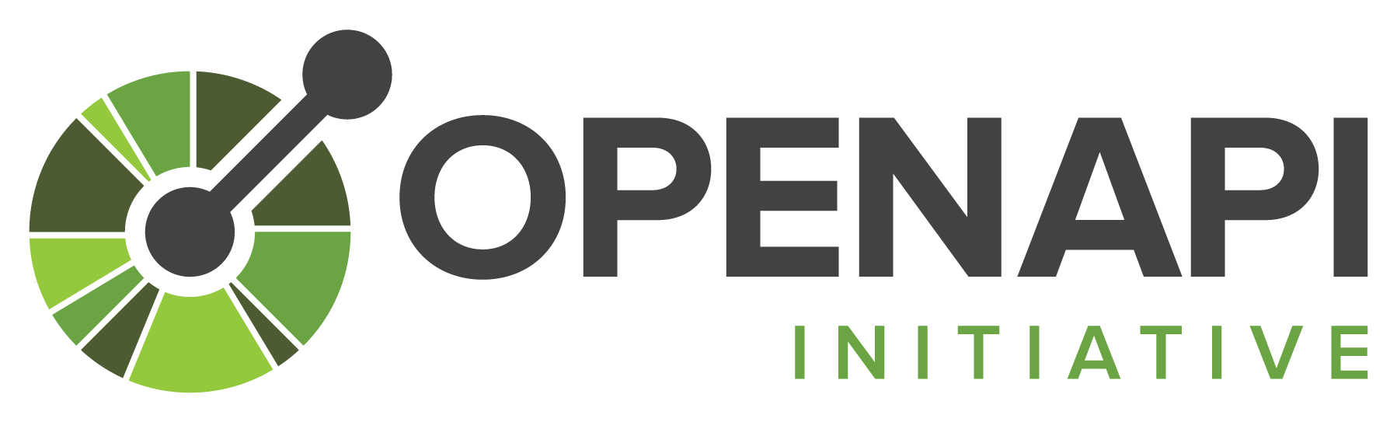




Agents include the following components
Azure AI Agent Service + Sementic Kernel SDK + Azure AI Service +
Azure Service
Agent's ability to make decisions, learn, act independently, without no constant human intervention
Agent can also talk to other agents to get things done. (multi agent)
Notes:
"autonomy" refers to the agent's ability to make decisions, learn, and act independently, without needing constant human intervention. Let's break it down with an example:
Imagine you have a virtual assistant named "Aisha" that helps you manage your daily tasks. Here’s how the autonomy area comes into play:
Planning: Aisha can plan your day by looking at your calendar, understanding your priorities, and suggesting a schedule that maximizes your productivity.
Example: If you have meetings from 9 AM to 11 AM and a project deadline at 3 PM, Aisha might suggest working on the project from 11:30 AM to 2 PM.
Learning: Aisha learns from your behavior and preferences over time. If she notices that you tend to work best in the mornings, she might start scheduling your most important tasks early in the day.
Example: After observing that you prefer to handle emails first thing in the morning, Aisha automatically schedules an email-checking session at 8 AM every day.
Decision Making: Aisha can make decisions on your behalf based on the information she has.
Example: If you receive an email requesting a meeting and your calendar is already full, Aisha can decide to propose an alternative time slot without needing to ask you every time.
Seeking Help: When Aisha encounters a task that she can't handle alone, she knows when to reach out for assistance or escalate the issue.
Example: If Aisha receives a technical question about a software tool that she can't answer, she might direct you to a human expert or provide resources where you can find the information.
By handling these tasks autonomously, Aisha saves you time and allows you to focus on more important things. Autonomy in agent systems enables them to be more efficient and helpful without constant oversight.

Slide 8
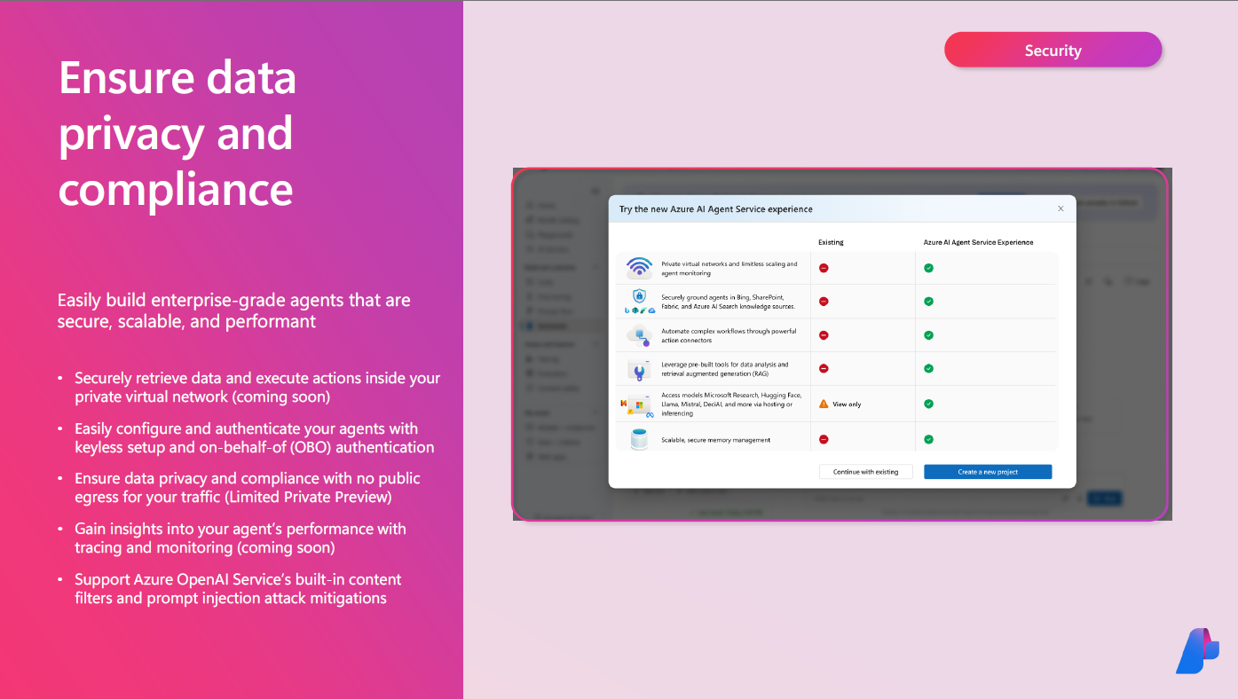

Slide 9
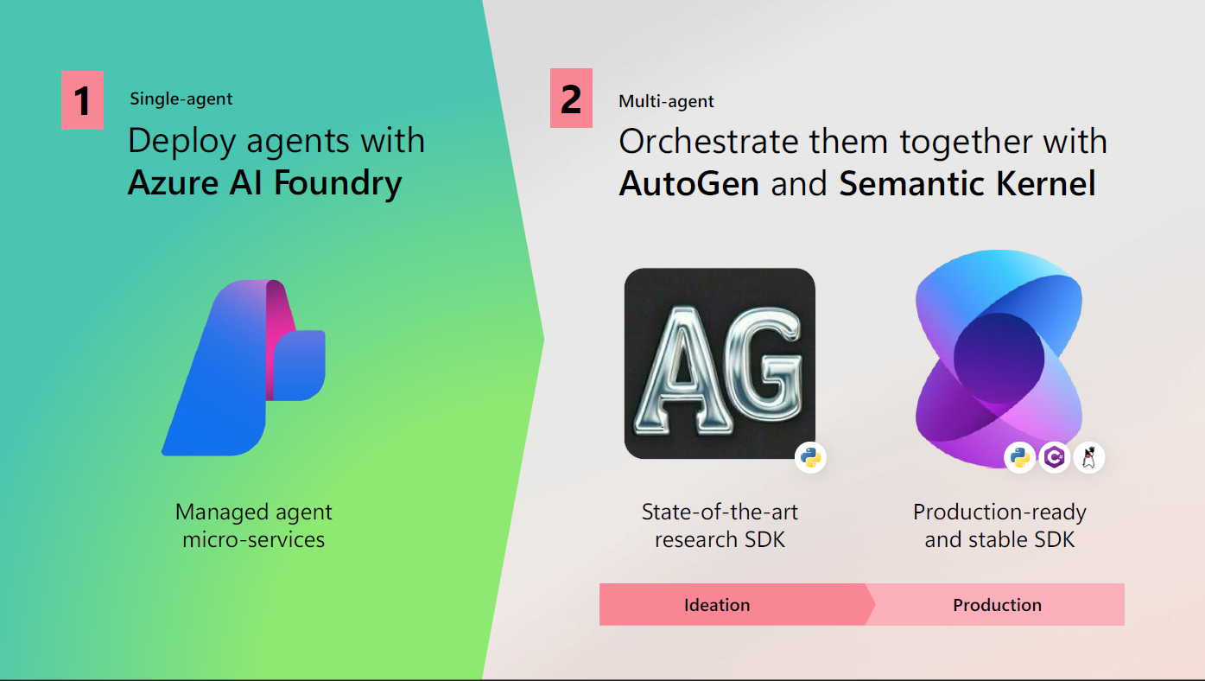

Slide 10
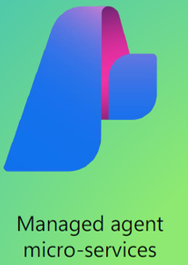
Within Azure AI Foundry, an AI Agent acts as a "smart" microservice that can be used to answer questions (RAG), perform actions, or completely automate workflows
Types of Agents | Purpose | Functionality | Use Cases | Integration | Tools
Ai Agent Service | A fully managed service designed to empower developers to build, deploy, and scale AI agents | Combines generative AI models with tools to access and interact with real-world data sources | Automate workflows, answer questions, perform actions, and integrate with other services use-case agnostic. This represents endless possibilities to automate routine tasks and unlock new possibilities for knowledge work | Uses the same wire protocol as Azure OpenAI Assistants, allowing easy integration with existing tools and services Azure AI Agent Service is flexible | Azure AI Foundry SDK: Provides tools to create and run AI agents with minimal coding Azure AI Services: Managed service to build, deploy, and scale AI agents securely
Notes:
Teams Toolkit: This Visual Studio Code extension helps you build declarative agents for Microsoft 365 Copilot.
Copilot Studio Agent Builder: A simple interface within Microsoft 365 Copilot to create agents using natural language or manual configuration.
Teams ToolkitBuild declarative agents using Teams Toolkit.Copilot StudioBuild declarative agents using the builder integrated in Copilot Studio.Copilot Studio agent builderBuild declarative agents using the integrated builder in Microsoft 365 Copilot.SharePointBuild declarative agents using grounding data from SharePoint files.
Azure AI Agent Service is flexible and use-case agnostic. This represents endless possibilities to automate routine tasks and unlock new possibilities for knowledge work - whether it is personal productivity agents that send emails and schedule meetings, research agents that continuously monitor market trends and automate report creation, sales agents that can research leads and automatically qualify leads, customer service agents that proactively follow-up with personalized messages, or developer agents that can upgrade your code base or evolve a code repository interactively.

Slide 11
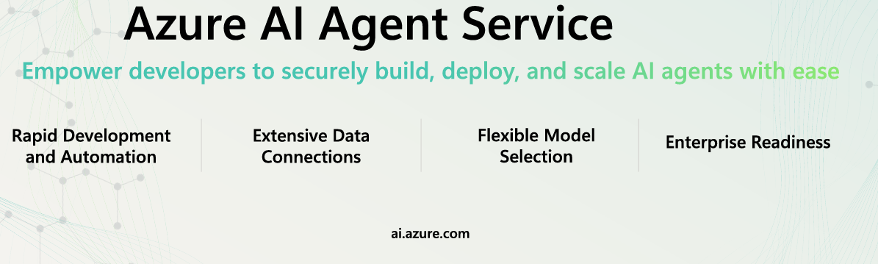
Why use Azure AI Agent Service? (compared to developing with the Inference API directly)
It provides a more streamlined and secure way to build and deploy AI agents. This includes:
Automatic tool calling – no need to parse a tool call, invoke the tool, and handle the response; all of this is now done server-side
Securely managed data – instead of managing your own conversation state, you can rely on threads to store all the information you need
Out-of-the-box tools – In addition to the file retrieval and code interpreter tools provided by Azure OpenAI Assistants, Azure AI Agent Service also comes with a set of tools that you can use to interact with your data sources, such as Bing, Azure AI Search, and Azure Functions.
What originally took hundreds of lines of code can now be done in just a few with Azure AI Agent Service.
Why use Azure AI Agent Service? (Compare to Many existing agent services )
1) the secure, integrated tools necessary for AI agents to perform real work
2) crucial context necessary for an agent to complete tasks is not missing
3) Here we can identify and diagnose issues.

